Slide 1

NATIONALISM IN INDIA
NATIONALISM
IN
INDIA

Slide 2
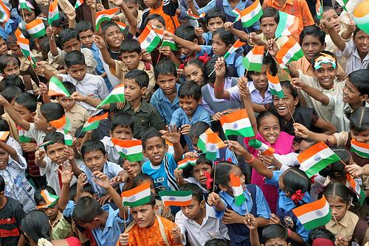
NATIONALISM
Nationalism is the feeling of oneness among the people living in a territory.

Slide 3
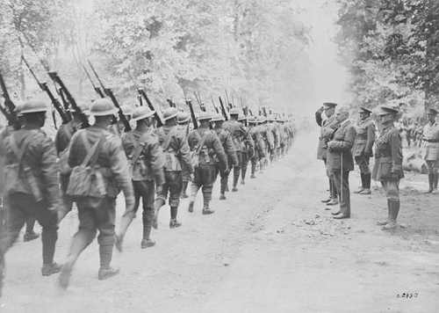
FIRST WORLD WAR BROKE OUT IN 1914

Slide 4
FIRST WORLD WAR CREATED A NEW ECONOMIC AND POLITICAL SITUATION IN INDIA
The British imposed war expenditure on India. Income tax was introduced. Customs duties were raised.
Prices of essential goods doubled during the war period.
Forced recruitment was made in to the British Indian army.
Crop failures resulted in shortage of food materials. Influenza epidemic spread in many parts of India. Millions of people lost their lives.

Slide 5
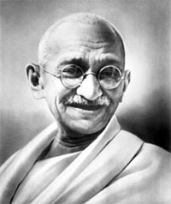
GANDHIAN SATYAGRAHA
Gandhiji came back to India in 1915.He introduced a new powerful method of struggle called Satyagraha.

Slide 6
SATYAGRAHA
Satyagraha literally means holding on to truth or truth force.
It was a non-violent struggle introduced by Gandhiji in the Indian National Movement.
It persuades the opponent to understand the truth.
If the cause was true and if the fight was against injustice then physical force was not necessary to fight the oppressor.
Hunger strike, peaceful demonstrations, strike, hartal and non cooperation with the government are some methods of Satyagraha

Slide 7
FIRST THREE SATYAGRAHA MOVEMENTS ORGANISED BY GANDHIJI IN INDIA
Champaran Movement [1916]: It was a movement of workers in the indigo plantations of the Champaran district of Bihar. It was against the oppressive plantation system.
Kheda Movement[1917]: Crop failure and plague epidemic made the life of the farmers miserable in the Kheda district of Gujarat. So, they started a movement under Gandhiji’s leadership with the demand for a reduction in land revenue.
Mill workers Movement: Low wages and poor working conditions forced the mill workers of Ahmedabad to start a movement under Gandhiji’s leadership in 1918.

Slide 8
Rowlatt Act[1919]
This Act gave the government the power to imprison any person without any trial for a period of two years.
Aim of this act was to destroy the national movement by imprisoning the national workers.
It was a black law because it was against basic human rights.

Slide 9
ROWLATT SATYAGRAHA
Gandhiji organiSed a non violent satyagraha against the Rowlatt Act.
A hartal was organiSed on 6 April 1919. Rallies were conducted. Shops were closed down. Workers conducted strike. Transport and communication systems came to a standstill.
These protests led to the Jallianwala Bagh Massacre.

Slide 10
JALLIANWALA BAGH MASSACRE
On 13 April 1919, a public meeting was organized at Jallianwala Bagh in Amritsar to protest against the arrests of national leaders.
Many villagers who came to attend a fair were also present in the park.
General Dyer reached the meeting place along with the British troops. He ordered the troops to fire. The firing lasted for nearly 10 minutes.
More than thousand people were killed and many were wounded. This incident is called Jallianwala Bagh Massacre.

Slide 11
KHILAFAT MOVEMENT
It was a movement organized by Muhammad Ali and Shaukat Ali [Ali brothers].
The aim of this movement was to protest against the injustice done to Turkey by Britain after the First World War.
The Turkish Sultan had the title of Caliph. The muslims considered him as their spiritual leader. So, many muslims joined this movement.

